Slide 1
EDI Transactions

Slide 2
EDI
The Health Insurance Portability and Accountability Act (HIPAA) of 1996 is intended to provide better access to health insurance, limit fraud and abuse, and reduce administrative costs of the health care industry.
The provisions for administrative simplification contained within HIPAA require the Department of Health and Human Services (HHS) to adopt standards to support the electronic exchange of administrative and financial health care transactions. These transactions primarily occur between health care providers and health insurance plans or clearinghouses.
HIPAA directs the Secretary of HHS to adopt standards for transactions to enable health information to be exchanged electronically and to adopt specifications for implementing each standard.
How to Read?
EDI companion guide : It is intended to convey information that is within the framework of the ASC X12N Implementation Guides adopted for use under HIPAA.
EDI Translators : An EDI translator allows to take one document that was customized in-house and convert it to an EDI standard

Slide 3
EDI Transactions
HIPAA X12 Transactions:
X12 270 = Health Insurance Eligibility Request
X12 271 = Health Insurance Eligibility Response
X12 837 = Health Care Claim
X12 835 = Health Care Claim Payment/Advice
X12 276 = Health Care Claims Status Inquiry
X12 277 = Health Care Claims Status Response
X12 278 = Health Care Claims Service Referral/Authorization
X12 834 = Benefit Enrollment and Maintenance
X12 820 = Premium Payment

Slide 4
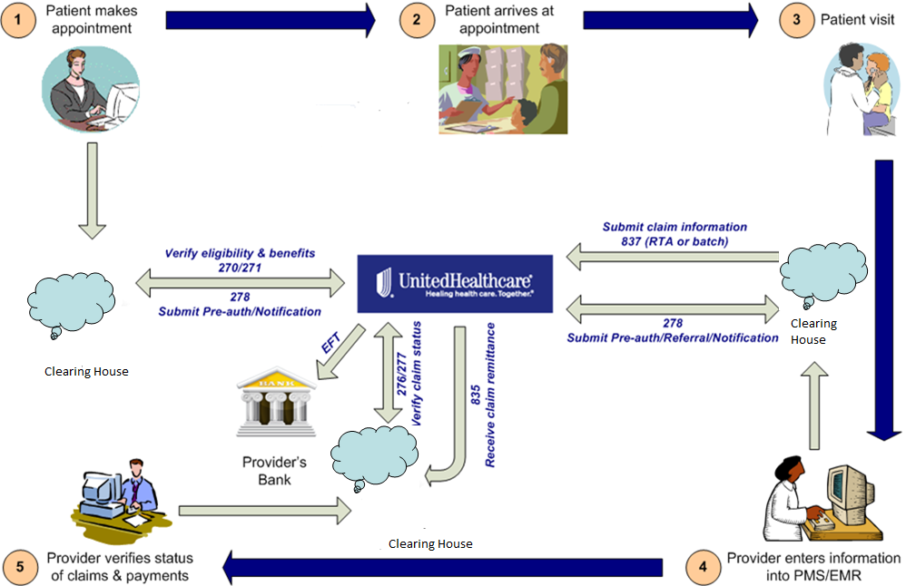
EDI Transaction Flow
E&I
C&S
M&R

Slide 5
Enterprise EDI
E D I
EDI-B2B is suite of business to business APIs & applications supporting HIPAA compliant healthcare data exchange and integration capability service pillar.
Servicing the needs of providers contracted with UHG and its alliances and is a part of the Horizontal services product capability domain.
It provides eligibility, claim status and provider search lookups. Provide integration capabilities for claim submission, enrollment, notification, authorization and referral.
Clients can transact with EDI in real time with a single transactions and in batch with multiple transactions in one file. External clients are typically large clearinghouses and large provider organizations.
EDI is a 24x7x365 availability CBA Tier1 application.
VOLUMES
348M (4.1 billion a year) Total EDI transactions
152M (1.82 billion a year) Eligibility Inquiry transactions
55M (660 million a year) Claim submissions
16M (188 million a year) Claim Status
75M (900 million a year) Vision
50M (600 million a year) Acknowledgements
TRANSACTIONS
270/271 Eligibility
837 Claims
837 RTA ( Real time )
274 Provider Search
276 Claims Status
278 Notification
278 Auth. and Referral
278 Inquiry
820 Premium Payment
835 Remittance
834 Enrollment
HL7

Slide 6








Enterprise EDI Ecosystem
Internal Partners
External Partners
External Partners
External Partners
Partners
Link Optum Rx Catamaran
Hospitals Clinics Providers
Medco Caremark
Govt. Agencies Employers
Channels
API GATEWAY
CLEARING HOUSE
MQ
ECG
B2B
EDI
270/271 Eligibility
276/277 Claims Status
278 Notification
278 Auth/Referral
Enrollment
835 Remittance
837 Claims
EDI Core Services
Pharmacy Claim
HL7 Lab Data
Claims Accumulator
IRS Submission
820 Premium Payment
837 RTA Claims
837 Outbound Claims
278 Inquiry
274 Provider Search
277 ACK Claim acknowledgement
T&C Enterprise Service
OTVM
Compliance
Enterprise HIPAA X12 Validation & Transformation Services
Backend
Systems
*CDB NDB *PES VISION GALAXY EEMS PRIME ICUE CIRRUS OXFORD INSURANCE SOLUTIONS PAYMENT ENGINE CLAIMS HIGHWAY *Claims360 NICE TOPS COSMOS UBH FACETS CSP FACETS DENTAL FACETS CAMS PH ACCENT
* Denotes HCP Data
15 Million Transactions a day
8 Million Eligibility Inquiry a day
3 Million Claims a day
1 Million Claims Status Check a day

Slide 7
Enterprise EDI Vision and Mission
O U R V I S I O N
STATE OF ART MODERN ENTERPRISE EDI
“Enable best-in class healthcare data integration experience between provider, clearing house and payer through enterprise EDI HIPAA compliant services by providing simplified, streamlined, standardized and adaptive process to integrate Trading partner data via modernized EDI platform ”.
Modern EDI platform creates strong controls, processing efficiency, and greater availability of reliable individual EDI products.
Adopts modern technologies and partners with organization’s strategic assets like HCP (C360, Claims360), PES (BDPaaS)
O U R M I S S I O N
TECHNOLOGY MODERNIZATION
Reduce TCO through modernization (OSFI)
EDI dashboards to monitor & track application health.
EDI 360 data to harvest EDI data, stream and predictive analytics utilizing AI/ML
Utilize emerging tech (Blockchain, Serverless etc)
PROCESS SIMPLIFICATION & AUTOMATION
Reduce provider phone calls
Increase EDI Adoption to automate transaction processing
Extended X12 to provide additional data.
Enhanced existing X12 provides more critical patient & payment data
Chat-Bots for business operations use.
ENHANCED SERVICE & DATA QUALITY
EDI Transaction Success Rate of 99% for 270/271 (97.44%) & 276/277 (93.44%)
HIPAA Compliance Rate of 99% for 270/271 (98.64%) & 276/277 (98.29%)
EDI Claim rejection rate < 0.4% (0.17%)
Raw error rate reduction
Data consistency (Link portals, PMS, Trading partner & Clearing house)

Slide 8
Thank You!!

